Slide 1
Problem 2 Text summerization

Slide 2
Text Summarization
Text summarization or automatic text summarization is the process in which a computer creates a shorter version of the original text (or a collection of texts) and at the same time preserves the relevancy of the information present in the original text.
Application of Text Summarization
Automatic grading of essay type answer scripts.
Text display on hand-held devices, such as PDA.

Slide 3
Proposed Method
the text summarization process consists of the following steps:
Find the unique terms in the given document
Decompose the document into individual sentences.
Represent each sentence as bag-of-terms.
Compute the Pearson Correlation similarity measure between each pair of sentences.
Find the relevance score for each sentence.
Arrange the sentences in descending order of their relevance score.
Extract the sentences starting from the highest relevance score till the compression ratio is obtained.

Slide 4


Proposed Method
Let a document D contains sentences D = (S₁, S₂,…, S_{n}).
Let document D contains T = (t₁, t₂, ... , t_{m}) unique terms.
Let F_{ij} = (f_{i1},f_{i2},…f_{im}), where f_{ij} is the number of occurrences of term t_{j} in Sentence S_{i}.
The similarity between sentences S_{i} and S_{l} can be calculated by
The relevance score can be generated by

Slide 5
Experiment Analysis
For our experiment, as a sample document, we take an answer script of Economics Subject of Sambalpur University.
The sample document contains 18 sentences with 59 unique terms.
For comparative analysis we have also used cosine similarity based summary.

Slide 6
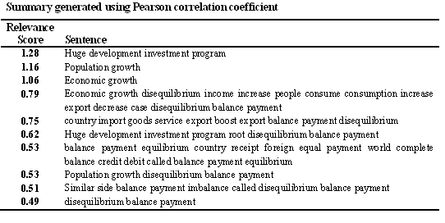
Summary Generated Using Pearson correlation Coefficient (PCC)

Slide 7
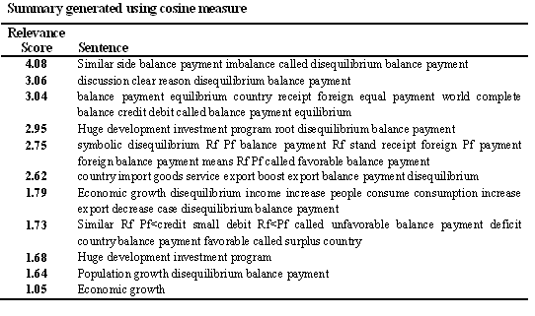
Summary Generated Using Cosine Measure

